Slide 1
CS305
System Modeling and Simulation
Prof. Dr. Khaled Mahar
khmahar@aast.edu
Lecture 5
Parts of this presentation is by Dr. Anis Koubâa and edited by Dr. Khaled Mahar

Slide 2
Chapter 7 Random-Number Generation
Banks, Carson, Nelson & Nicol
Discrete-Event System Simulation

Slide 3
Goals
Understand the fundamental concepts of Random Number Generators (RNGs)
Lean how to generate random variate for standard uniform distributions in the interval [0,1]
Learn how to generate random variate for any probability distribution.

Slide 4
Why Random Number Generators?
Random Numbers (RNs) are needed for doing simulations
Generate random arrivals (Poisson), random service times (Exponential)
Random numbers must be Independent (unpredictable)
NOW
A1
A2
A3
Random Inter-Arrival Time: Exp(A)
Random Service Time: Exp(μ)
D1

Slide 5
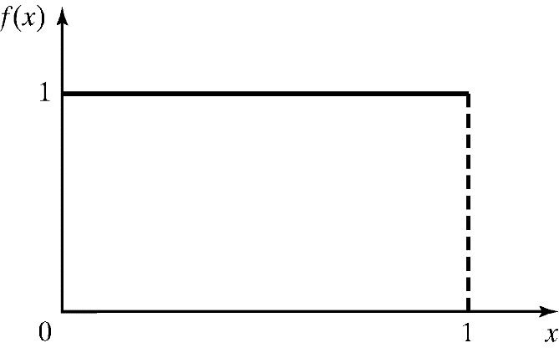
Properties of Random Numbers
Random Number, R_{i}, must be independently drawn from a uniform distribution with pdf:
pdf for random numbers
A sequence of numbers is called random if the numbers possess these two statistical properties
Uniformity: every number is equally likely to occur
Independence: the occurrence of a number is independent of the occurrence of another

Slide 6
Generation of Pseudo-Random Numbers
“Pseudo”, because generating numbers using a known method removes the potential for true randomness.
Goal: To produce a sequence of numbers in [0,1] that simulates the ideal properties of random numbers (RN).
Important considerations in RN routines:
Fast
Portable to different computers
Have sufficiently long cycle
Replicable
Closely approximate the ideal statistical properties of uniformity and independence.

Slide 7
Problem Statement of RNGs
Problem: We want to create a function:
u = rand();
that
produces a floating point number u, where 0<u<1
AND
any value strictly greater than 0 and less than 1 is equally likely to occur (Uniform Distribution in ]0,1[ )
0.0 and 1.0 are excluded from possible values

Slide 8
Problem Statement of RNGs
This problem can be simply resolved by the following technique:
For a large integer m, let the set χ_{m} = {1, 2, … m-1}
Draw in an integer x ∈ χ_{m} randomly
Compute: u = x/m
m should be very large
Our problem reduces to determining how to randomly select an integer in χ_{m}

Slide 9
Techniques for Generating Random Numbers
There many techniques, some of them are:
Linear Congruential Method (LCM).
Combined Linear Congruential Generators (CLCG).
Random-Number Streams.

Slide 10
Linear Congruential Method
To produce a sequence of integers, X₁, X₂, … between 0 and m-1 by following a recursive relationship:
The selection of the values for a, c, m, and X₀ affects the statistical properties and the cycle length.
The random integers are being generated in [0,m-1], and to convert the integers to random numbers, use:
The multiplier
The increment
The modulus

Slide 11
Example [LCM]
Use X₀ = 27, a = 17, c = 43, and m = 100.
The X_{i} and R_{i} values are:
X₁ = (17*27+43) mod 100 = 502 mod 100 = 2, R₁ = 0.02;
X₂ = (17*2+43) mod 100 = 77, R₂ = 0.77;
X₃ = (17*77+43) mod 100 = 52, R₃ = 0.52;
…

Slide 12
Linear Congruential Method
To produce a sequence of integers, X₁, X₂, … between 0 and m-1 by following a recursive relationship:
c =0 : multiplicative congruential method
c ≠ 0 : mixed congruential method.
The multiplier
The increment
The modulus

Slide 13
Techniques for Generating Random Number (cont.)
The max period(P) is:
For m a power of 2, say m = 2^{b}, and c ≠ 0, the longest possible period is P = m = 2^{b} , which is achieved provided that c is relatively prime to m (that is, the greatest common factor of c and m is 1), and a = 1 + 4k, where k is an integer.
For m a power of 2, say m = 2^{b}, and c = 0, the longest possible period is P = m / 4 = 2^{b-2} , which is achieved provided that the seed X₀ is odd and the multiplier, a, is given by a = 3 + 8k or a = 5 + 8k, for some k = 0, 1,...
Notes:
30

Slide 14
Techniques for Generating Random Number (cont.)
For m a prime number and c = 0, the longest possible period is P = m - 1, which is achieved provided that the multiplier, a, has the property that the smallest integer k such that a^{k} - 1 is divisible by m is k = m - 1,
Notes:
30

Slide 15
Multiplicative Congruential Method
The mod function ensures a value lower than m is always produced
If the generator produces the value 0, then all subsequent numbers in the sequence will be zero ☹ (This is not desired)
Theorem if (m is prime and initial seed is non-zero) then the generator will never produce the value 0
In this case, the RNG produces values in χ_{m} = {1, 2, … m-1}

Slide 16
Observations
The above equation simulates drawing balls from an urn without replacement, where each value in χ_{m} represents a ball
The requirement of randomness is violated because successive draws are not independent
Practical Fact: The random values can be approximately considered as independent if the number of generated random variates (ball draws) is << m
The Quality of the random number generator is dependent on good choices for a and m

Slide 17
The Period of a Sequence
Consider sequence produced by:
Once a value is repeated, all the sequence is then repeated itself
Sequence: where
p is the period: number of elements before the first repeat, p ≤ m-1

Slide 18
The Period of a Sequence
Period Determination Using Various seeds for a = 13, m = 2⁶
i X_{i} X_{i} X_{i} X_{i}
0 1 2 3 4
1 13 26 39 52
2 41 18 59 36
3 21 42 63 20
4 17 34 51 4
5 29 58 23
6 57 50 43
7 37 10 47
8 33 2 35
9 45 7
10 9 27
11 53 31
12 49 19
13 61 55
14 25 11
15 5 15
16 1 3
Notes:
30

Slide 19
Full Period Sequences
Ideally, the generator cycles through all values in χ_{m} to maximize the number of possible values that are generated, and guarantee any number can be produced
The sequence containing all possible numbers is called a full-period sequence (p = m-1)

Slide 20
Modulus and Multiplier Selection Criteria
Selection Criteria 1: m to be “as large as possible”
m = 2^{i} - 1 where i is the machine precision (is the largest possible positive integer on a “two’s complement” machine)
Recall m must be prime
It happens that 2³¹-1 is prime (for a 32 bit machine)
Unfortunately, 2¹⁵-1 and 2⁶³-1 are not prime ;-(
Selection Criteria 2: p gives full-period sequence (p = m-1)
For a given prime number m, select multiplier a that provide a full period
Algorithm to test if a is a full-period multiplier (m must be prime):

Slide 21
Modulus and Multiplier Selection Criteria
Criterias
m to be “as large as possible”
p gives full-period sequence (p = m-1)
Algorithm for finding if p is full-period multiplier
p = 1;
x = a; // assume, initial seed is x0=1, thus x1=a
while (x != 1) { // cycle through numbers until repeat
p++;
x = (a * x) % m; // careful: overflow possible
}
if (p == m-1) // a is a full period multiplier
else // a is not a full period multiplier

Slide 22
Implementation Issues
Assume we have a 32-bit machine, m=2³¹-1
Problem
Must compute
Obvious computation is to compute first, then do mod operation
The multiplication might overflow, especially if m-1 is large!
First Solution: Floating point solution
Could do arithmetic in double precision floating point
Double has 53-bits precision in IEEE floating point
May have trouble porting to other machines
Integer arithmetic faster than floating point

Slide 23
Implementation Issues: Mathematical Solutions
Problem: Compute without overflow
General Idea: Perform mod operation first, before multiplication.
Suppose that (not prime)
We have:
Thus, No overflow
Notes:
ax mod m=ax-m*int(ax/m)

Slide 24
Test for Random Numbers
1. Frequency test. Uses the Kolmogorov-Smirnov or the chi-square test to compare the distribution of the set of numbers generated to a uniform distribution.
2. Autocorrelation test. Tests the correlation between numbers and compares the sample correlation to the expected correlation of zero.
Notes:
30
Frequency test is to validate the uniformity of the generator
Kolmogorov-Smirnov: Compares the continuous CDF, F(x), of the uniform distribution with the empirical CDF, S_{N}(x), of the N sample observations.

Slide 25
Tests for Random Numbers
When to use these tests:
If a well-known simulation languages or random-number generators is used, it is probably unnecessary to test
If the generator is not explicitly known or documented, e.g., spreadsheet programs, symbolic/numerical calculators, tests should be applied to many sample numbers.
Types of tests:
Theoretical tests: evaluate the choices of m, a, and c without actually generating any numbers
Empirical tests: applied to actual sequences of numbers produced.

Slide 26
Test for Random Numbers (cont.)
In testing for uniformity, the hypotheses are as follows:
H₀: R_{i} ~ U[0,1]
H₁: R_{i} ≠ U[0,1]
The null hypothesis, H₀, reads that the numbers are distributed uniformly on the interval [0,1].
Notes:
30

Slide 27
Test for Random Numbers (cont.)
In testing for independence, the hypotheses are as follows;
H₀: R_{i} ~ independently
H₁: R_{i} ≠ independently
This null hypothesis, H₀, reads that the numbers are independent. Acceptance of the null hypothesis means that no evidence of dependence has been detected on the basis of this test.
Notes:
30

Slide 28
Test for Random Numbers (cont.)
Level of significance α
α = P(reject H₀ | H₀ true)
Frequently, α is set to 0.01 or 0.05
(Hypothesis)
Actually True Actually False
Accept 1 - α β
(Type II error)
Reject α 1 - β
(Type I error)
Notes:
30

Slide 29
Tests for Random Numbers
Two categories:
Testing for uniformity:
H₀: R_{i} ~ U[0,1]
H₁: R_{i} ~ U[0,1]
Failure to reject the null hypothesis, H₀, means that evidence of non-uniformity has not been detected.
Testing for independence:
H₀: R_{i} ~ independently
H₁: R_{i} ~ independently
Failure to reject the null hypothesis, H₀, means that evidence of dependence has not been detected.
Level of significance α, the probability of rejecting H₀ when it is true: α = P(reject H₀|H₀ is true)

Slide 30
Frequency Tests
Test of uniformity
Two different methods:
Kolmogorov-Smirnov test
Chi-square test

Slide 31
Kolmogorov-Smirnov Test [Frequency Test]
Compares the continuous cdf, F(x), of the uniform distribution with the empirical cdf, S_{N}(x), of the N sample observations.
We know:
If the sample from the RN generator is R₁, R₂, …, R_{N}, then the empirical cdf, S_{N}(x) is:
Based on the statistic: D = max| F(x) - S_{N}(x)|
Sampling distribution of D is known (a function of N, tabulated in Table A.8.)
Notes:
The chi-square critical values are readily available from tables in statistics books. These values are organized by degrees of freedom, d, and significance level, α. The degrees of freedom parameter is given by d = J – E – 1, where E is the distribution-dependent number of parameters estimated from the sample data. For instance, the gamma distribution Gamm(a, b) requires E = 2 parameters to be estimated from the sample, while the exponential distribution Expo(λ) only requires E= 1 parameter.

Slide 32
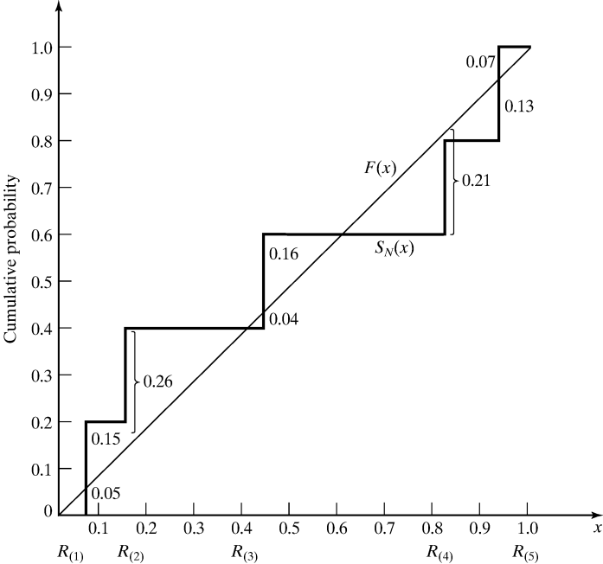
Kolmogorov-Smirnov Test [Frequency Test]
Example: Suppose 5 generated numbers R_{(i)} are 0.44, 0.81, 0.14, 0.05, 0.93.
Arrange R_{(i)} from smallest to largest
x_{i}=R_{(i)} | 0.05 | 0.14 | 0.44 | 0.81 | 0.93
F(x) | 0.05 | 0.14 | 0.44 | 0.81 | 0.93
S_{N}(x) | 0.20 | 0.40 | 0.60 | 0.80 | 1.00
|S_{N}(x) - F(x)| | 0.15 | 0.26 | 0.16 | 0.01 | 0.07
D= max |S_{N}(x) - F(x)|
D = max |SN(x) - F(x)| = 0.26
For α = 0.05, D_{α} = 0.565
since D< D_{α} H₀ is not rejected.
Notes:
D⁺:largest deviation of S_{N}(x) above F(x), and D⁻: is the largest deviation of S_{N}(x) below F(x).
at R3: D⁺=0.16 and D⁻=0.04
D_{α} ισ χαλλεδ χριτιχαλ ϖαλυε

Slide 33
Chi-square test [Frequency Test]
Chi-square test uses the sample statistic:
Approximately the chi-square distribution with n-1 degrees of freedom (where the critical values are tabulated in Table A.6)
For the uniform distribution, E_{i}, the expected number in the each class is:
Valid only for large samples, e.g. N >= 50
n is the # of classes
E_{i} is the expected # in the i^{th} class
O_{i} is the observed # in the i^{th} class

Slide 34
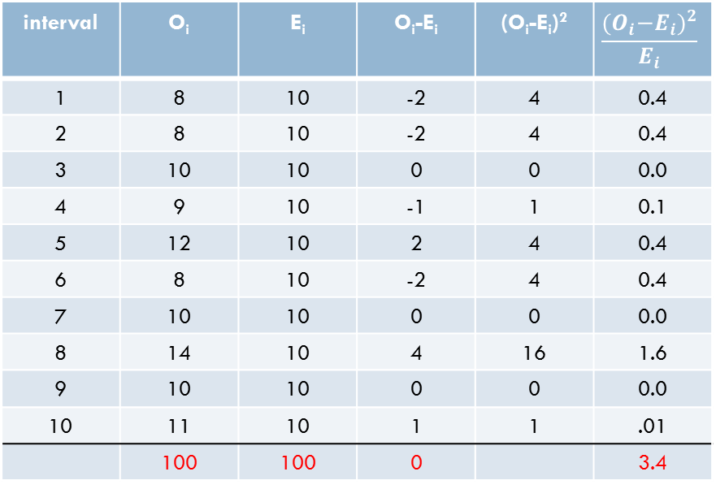

Chi-square Test Example
Use the chi-square test with α=0.05 to test whether the data which has the histogram shown below are uniformly distributed.
[0,0.1) | [0.1,0.2) | [0.2,0.3) | [0.2,0.3) | [0.2,0.3) | [0.2,0.3) | [0.2,0.3) | [0.2,0.3) | [0.2,0.3) | [0.2,0.3)
8 | 8 | 10 | 9 | 12 | 8 | 10 | 14 | 10 | 11
interval | O_{i} | E_{i} | O_{i}-E_{i} | (O_{i}-E_{i})² | $$\frac{{{(O}_{i}−E_{i})}^{2}}{E_{i}}$$
1 | 8 | 10 | -2 | 4 | 0.4
2 | 8 | 10 | -2 | 4 | 0.4
3 | 10 | 10 | 0 | 0 | 0.0
4 | 9 | 10 | -1 | 1 | 0.1
5 | 12 | 10 | 2 | 4 | 0.4
6 | 8 | 10 | -2 | 4 | 0.4
7 | 10 | 10 | 0 | 0 | 0.0
8 | 14 | 10 | 4 | 16 | 1.6
9 | 10 | 10 | 0 | 0 | 0.0
10 | 11 | 10 | 1 | 1 | .01
 | 100 | 100 | 0 |  | 3.4
$$χ_{0}^{2}=3.4$$
The critical value:
$$χ_{0.05,9}^{2}=16.9$$
$χ_{0}^{2}$ <$χ_{0.05,9}^{2}$
Hence, null hypothesis is accepted

Slide 35
Tests for Autocorrelation [Tests for RN]
Testing the autocorrelation between every m numbers (m is a.k.a. the lag), starting with the i^{th} number
The autocorrelation ρ_{im} between numbers: R_{i}, R_{i+m}, R_{i+2m}, R_{i+(M+1)m}
M is the largest integer such that
Hypothesis:
If the values are uncorrelated:
For large values of M, the distribution of the estimator of ρ_{im}, denoted is approximately normal.
Notes:
A nonzero autocorrelation implies a lack of independence.

Slide 36
Tests for Autocorrelation [Tests for RN]
Test statistics is:
Z₀ is distributed normally with mean = 0 and variance = 1, and:
If ρ_{im} > 0, the subsequence has positive autocorrelation
High random numbers tend to be followed by high ones, and vice versa.
If ρ_{im} < 0, the subsequence has negative autocorrelation
Low random numbers tend to be followed by high ones, and vice versa.

Slide 37
Example [Test for Autocorrelation]
Test whether the 3rd, 8th, 13th, and so on, for the following output on P. 309.
Hence, α = 0.05, i = 3, m = 5, N = 30, and M = 4
From Table A.3, z_{0.025} = 1.96. Hence, the hypothesis is not rejected.

Slide 38
Next
Random number variates
Discrete random variables
Continuous random variables

Slide 39
Chapter 8 Random-Variate Generation
Banks, Carson, Nelson & Nicol
Discrete-Event System Simulation

Slide 40
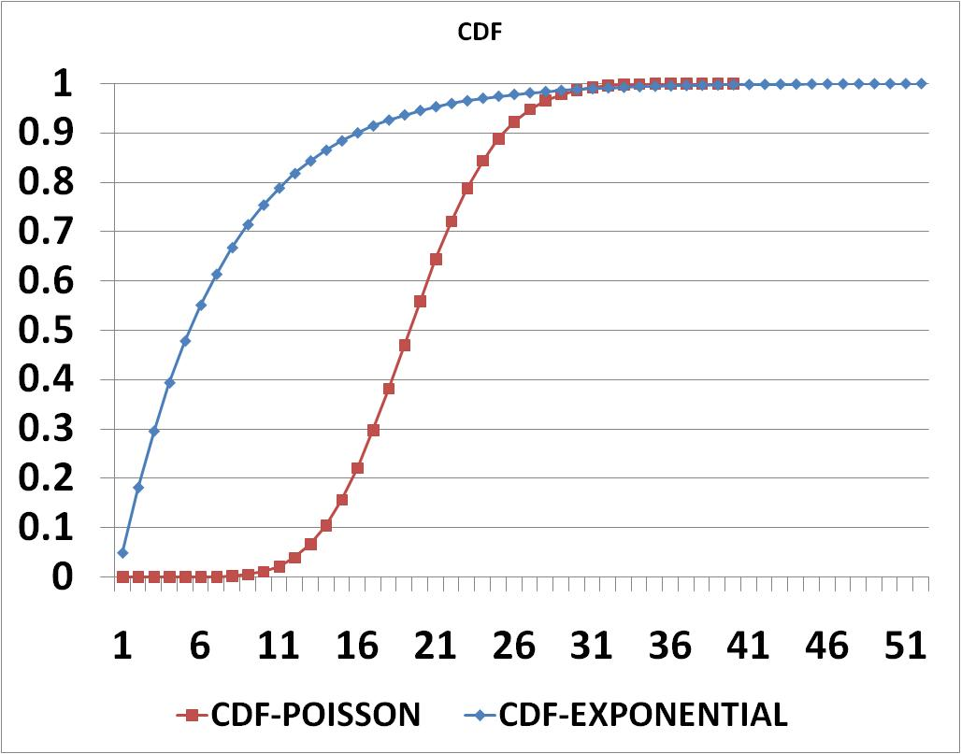
The Concept of Inverse Transformation
Goal: create random variates for random variables X of a certain distribution defined with its CDF
Approach: Inverse cumulative distribution function
CDF F(x)=u
u₂
u₁
Cumulative Distribution Function
Generate a random variable
Determine x such that
X1_{Exp}
X2_{Exp}
X2_{Poisson}
X1_{Poisson}

Slide 41
Generating Discrete Random Variates
PDF
x | f(x)
1 | 0.2
2 | 0.3
3 | 0.1
4 | 0.2
5 | 0.2
Random variate generation:
1. Select u, uniformly distributed (0,1)
2. Compute F*(u); result is random variate with distribution f()
F(x)
F(x)
1.0
u = F(x)
0.5 = F(2)
1.0
x = F*(u)
2 = F(0.5)
0.8
0.8
0.6
0.6
u
u
0.4
f(x=2)
0.4
0.2
0.2
1
2
3
4
5
x
1
2
3
4
5
x
x
x
Cumulative Distribution Function of X:
F(x) = P(X≤x)
Inverse Distribution Function (idf) of X:
F*(u) = min {x: u < F(x)}

Slide 42
Discrete Random Variate Generation
Bernoulli(p):
Return 1 with probability p,
Return 0 with probability 1-p
Geometric(p):
x: number of Bernoulli trials until first ‘0’)
Uniform (a,b): equally likely to select an integer in interval [a,b]

Slide 43
Geometric Random Variates
Generate random variate x from geometric distribution with probability of success p=0.3,for u=0.7drawn from U(0,1).
Recall that the geometric cdf is given by
Solving the above for x to obtain the inverse cdf formula
Substituting p=0.2 and u=0.1024 to get x=4

Slide 44
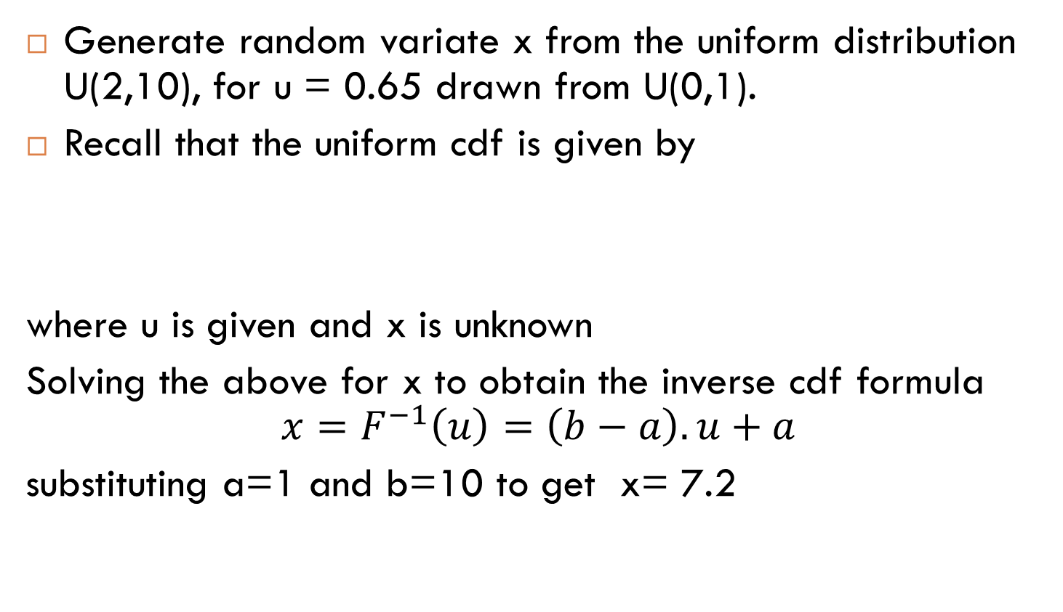
Uniform Random Variates
Generate random variate x from the uniform distribution U(2,10), for u = 0.65 drawn from U(0,1).
Recall that the uniform cdf is given by
where u is given and x is unknown
Solving the above for x to obtain the inverse cdf formula
$$x=F^{−1}\left(u\right)=\left(b−a\right).u+a$$
substituting a=1 and b=10 to get x= 7.2

Slide 45
Exponential Random Variates
Generate random variate x from exponential distribution Exp(0.5) of rate λ=0.5 (µ=2),for u=0.45 drawn from U(0,1).
Recall that the exponential cdf can be rewritten as
Solving the above for x to obtain the inverse cdf formula
Substituting λ=0.5 and u=0.45 to get x=1.1957

